Slide 1
Evil Corp Challenge
GROUP 1: Hemanth Bojja 11702675 Vamsi Pavan Krishna Dasineni 11658186 Aryanth Reddy Kondreddy 11696947 Sushmitha Inapakuthika 11696399

Slide 2
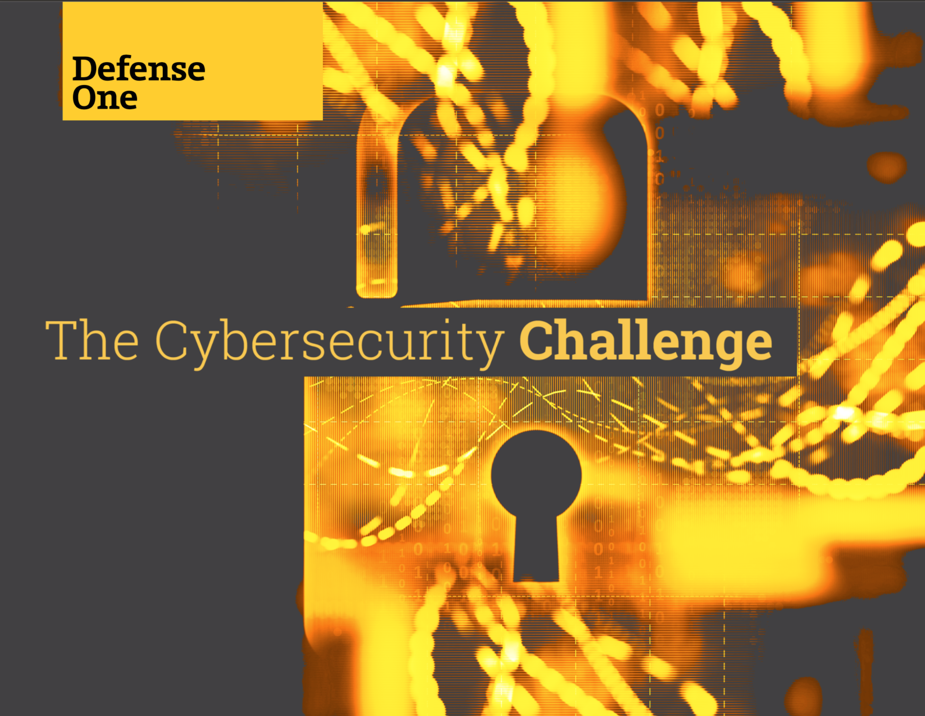
Introduction
The "Evil Corp" challenge is a pwn (exploitation) category challenge in cybersecurity competitions.
It is designed to assess participants' skills in identifying and exploiting vulnerabilities in a simulated environment.
Participants are required to find and exploit vulnerabilities within the challenge to gain control or access to specific resources.
Notes:
Image source: https://www.govexec.com/assets/cybersecurity-challenge-d1-q4-2019/portal/

Slide 3
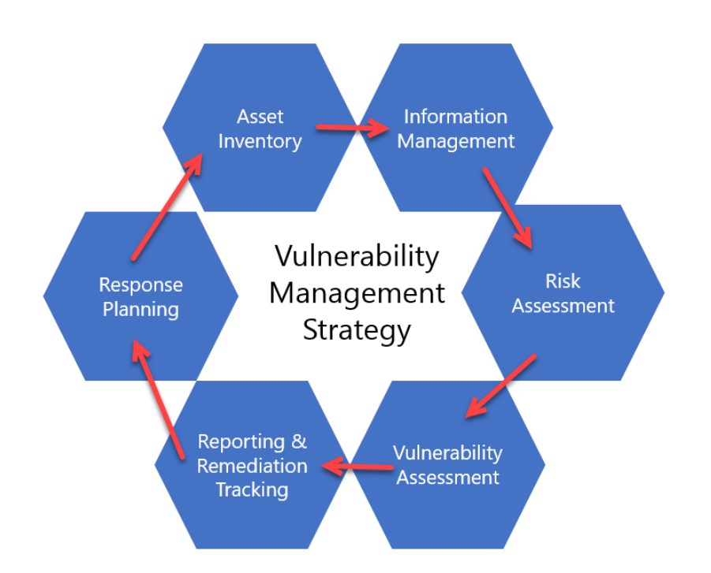
Understanding the Challenge
Pwn challenges typically involve finding security vulnerabilities in software or systems.
Participants need to analyze the given scenario, understand the vulnerabilities present, and devise an exploit.
The goal is to demonstrate the ability to think like a hacker and exploit weaknesses for educational purposes.
Notes:
Image source: https://zsecurity.org/creating-a-vulnerability-management-strategy/

Slide 4

Types of Exploitation
Common exploitation techniques in pwn challenges include buffer overflows, format string vulnerabilities, and use-after-free exploits.
Participants may need to write or modify exploit code to gain control over the target system.
Understanding memory management, assembly language, and debugging techniques are essential for success.
Notes:
Image source: https://hackmag.com/security/stack-overflow/

Slide 5
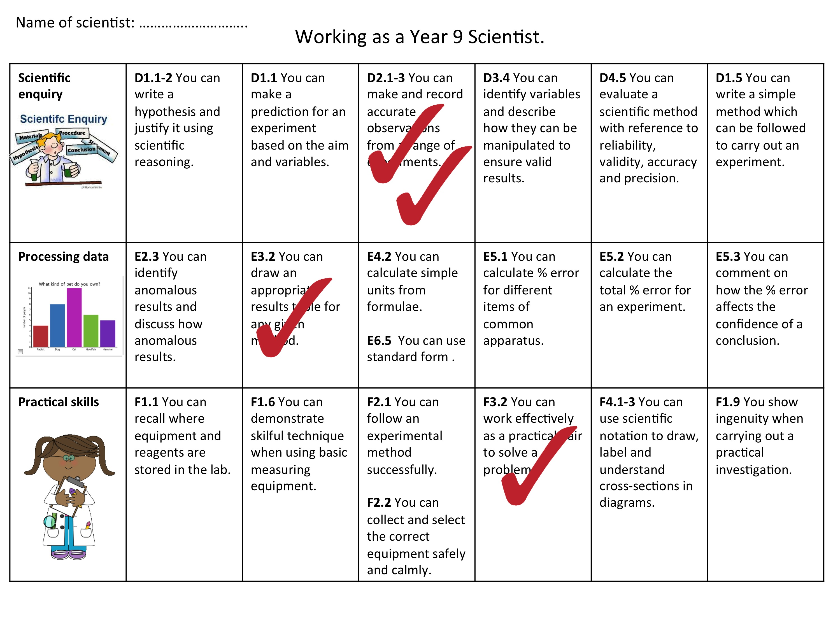
Importance of Skills Assessment
The "Evil Corp" challenge allows participants to showcase their technical skills in a competitive environment.
It helps assess participants' proficiency in reverse engineering, exploit development, and vulnerability analysis.
Competing in such challenges can enhance participants' knowledge and practical skills in cybersecurity.
Notes:
Image source: https://imsyaf.com/job-skills-assessment-worksheet/

Slide 6
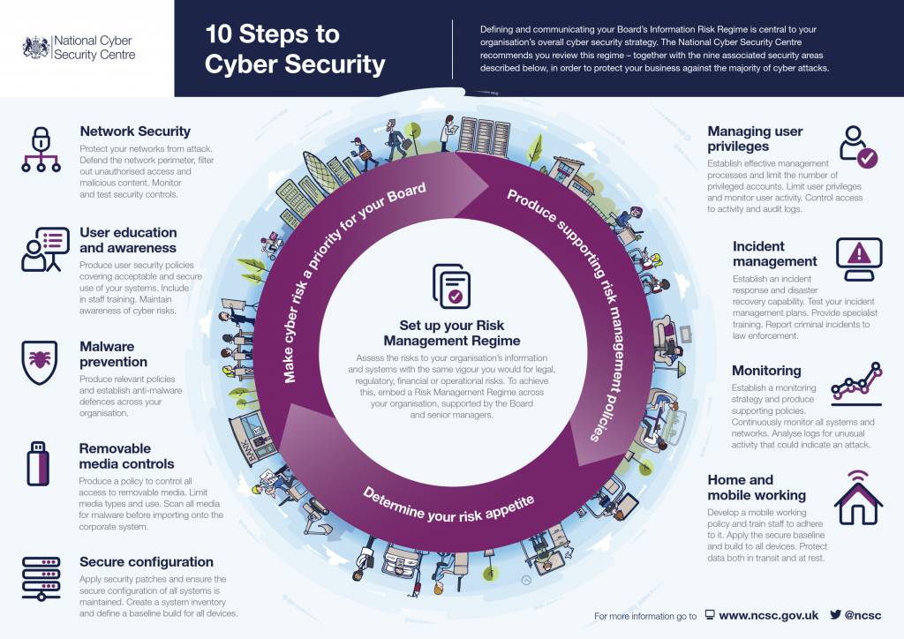
Real-World Relevance
The skills tested in pwn challenges are directly applicable to real-world scenarios in cybersecurity.
Identifying and exploiting vulnerabilities is crucial for securing systems and applications.
Professionals with expertise in exploitation techniques are in high demand in the cybersecurity industry.
Notes:
Image source: https://lucycalnandesign.co.uk/cyber-security-infographics/

Slide 7
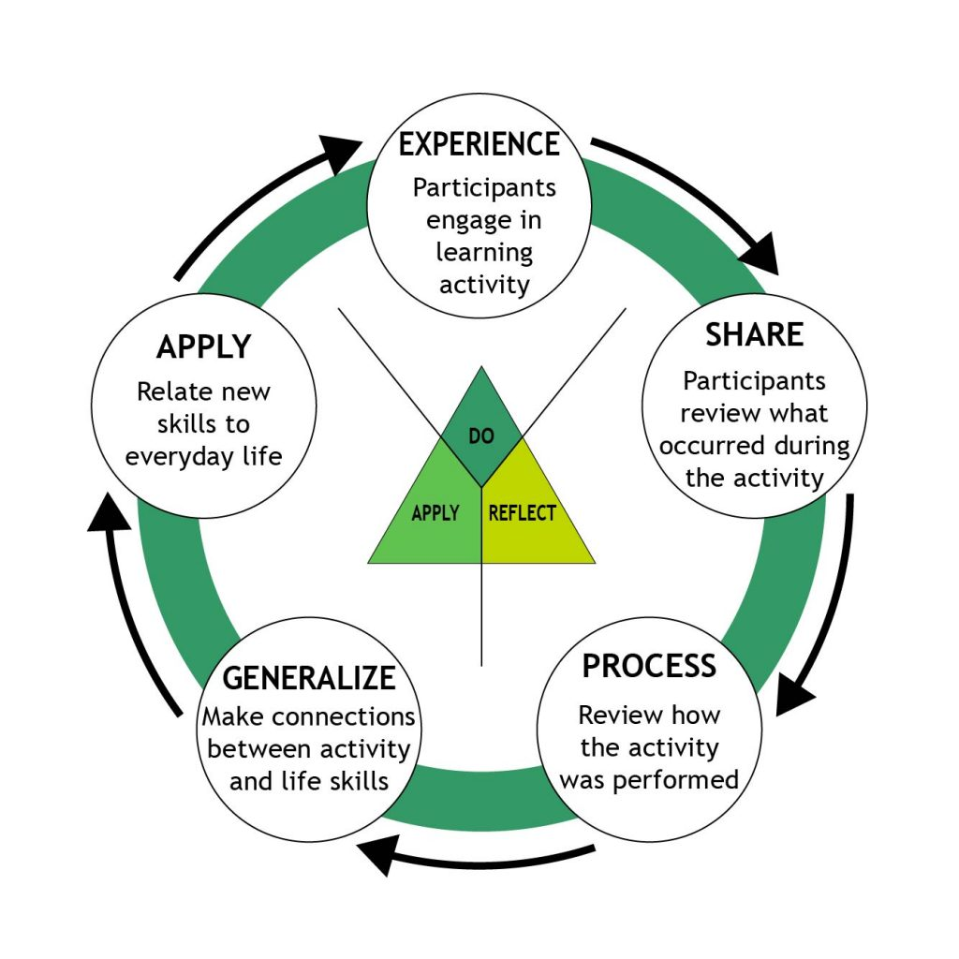
Learning Opportunities
Participating in pwn challenges like "Evil Corp" provides hands-on experience in offensive security techniques.
Participants can learn new exploit development skills, enhance their problem-solving abilities, and expand their knowledge of security concepts.
Feedback from challenges can help participants improve their skills and techniques for future engagements.
Notes:
Image source: https://4h.extension.wisc.edu/resources/volunteer-resources/4-h-foundations/experiential-learning-model/

Slide 8

Collaboration and Networking
Pwn challenges often encourage collaboration among participants to solve complex problems.
Networking with other cybersecurity enthusiasts and professionals in the field can lead to valuable learning opportunities and career connections.
Sharing knowledge and experiences with peers can foster a supportive community of like-minded individuals.
Notes:
Image source: https://skylineg.com/resources/blog/the-3-steps-to-maximizing-your-collaboration-skills

Slide 9
Ethical Considerations
It is crucial for participants in pwn challenges to adhere to ethical guidelines and rules of engagement.
Engaging in ethical hacking practices, respecting privacy and confidentiality, and obtaining proper authorization are essential.
Upholding ethical standards in cybersecurity competitions reflects professionalism and integrity in the industry.
Notes:
Image source: https://www.researchgate.net/figure/Ethical-considerations-Source-Designed-by-Authors_fig1_338435600

Slide 10

Continuous Learning and Improvement
The "Evil Corp" challenge and similar pwn challenges serve as a platform for continuous learning and skill development.
Participants can leverage feedback, engage in post-challenge analysis, and seek further training to enhance their capabilities.
Embracing a growth mindset and a commitment to ongoing improvement are key to succeeding in cybersecurity challenges.
Notes:
Image source: https://www.iedunote.com/continuous-learning

Slide 11
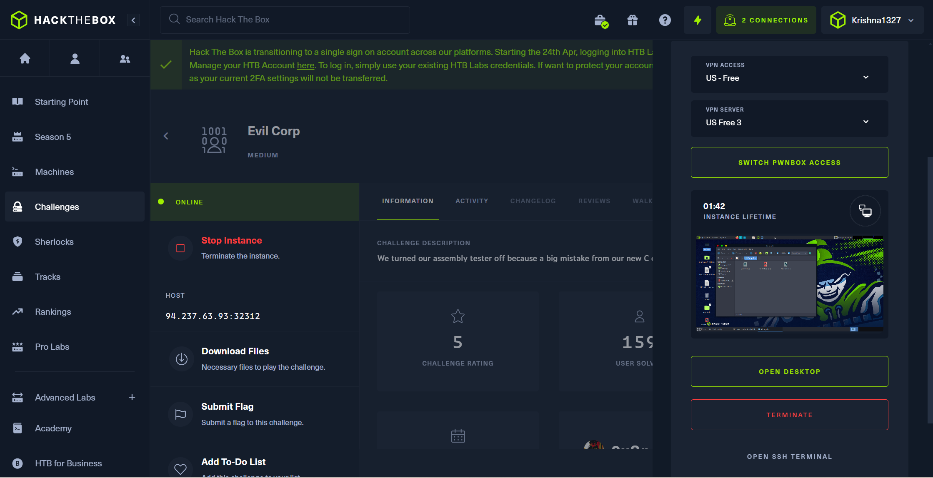

Implementation

Slide 12
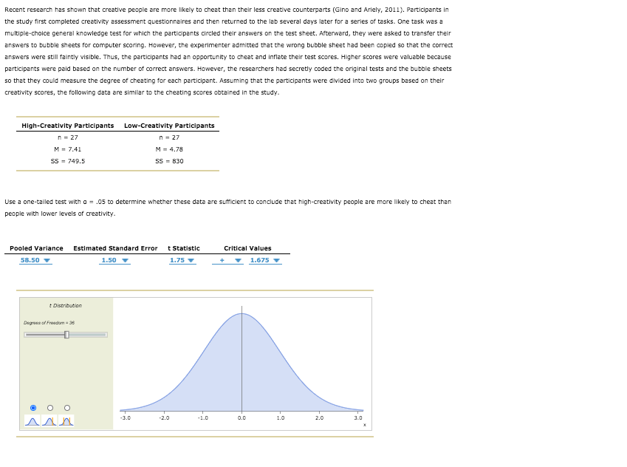
Conclusion
The "Evil Corp" challenge is a valuable opportunity for participants to test their pwn (exploitation) skills in a controlled environment.
By engaging in such challenges, participants can sharpen their technical abilities, gain practical experience, and demonstrate their expertise in offensive security.
Embracing the challenge, learning from experiences, and staying curious are essential for personal and professional growth in the field of cybersecurity.

Slide 13
References
Cybersecurity Competitions: Benefits and Best Practices. (n.d.). Retrieved from https://www.nist.gov/cyberframework/cybersecurity-competitions-benefits-and-best-practices
Aboagye, E., Yawson, J. A., & Appiah, K. N. (2021). COVID-19 and E-learning: The challenges of students in tertiary institutions. Social Education Research, 1-8.
https://app.hackthebox.com/login?redirect=%2Fchallenges%2FEvil%2520Corp

